Slide 1
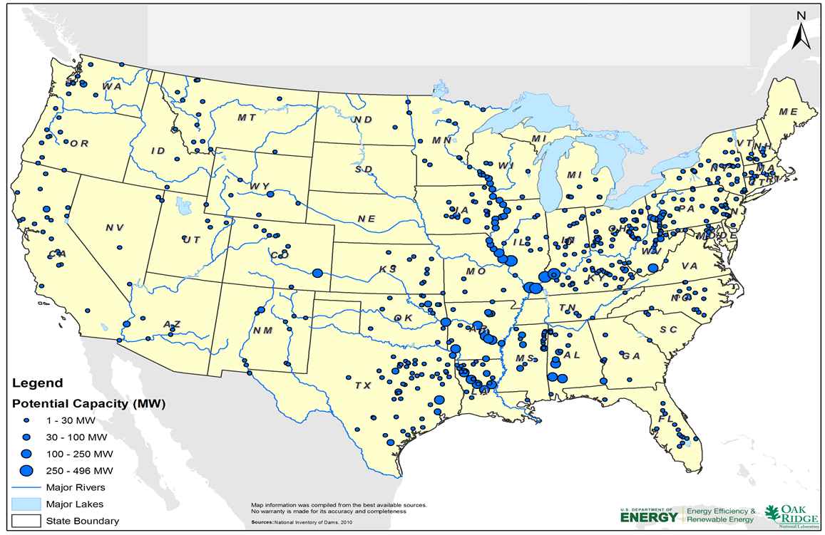
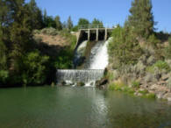
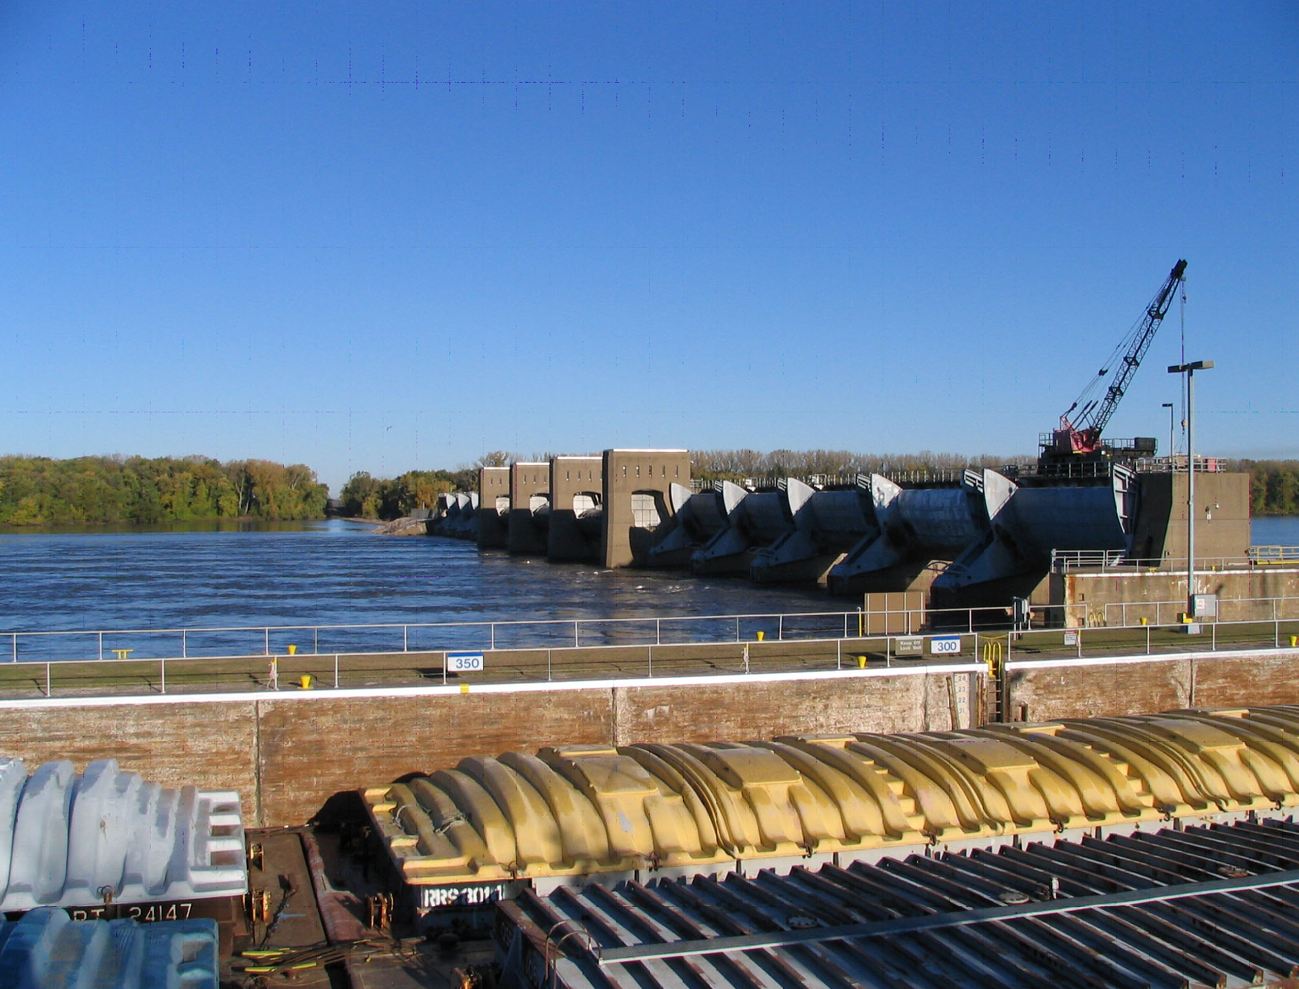
Water Power Peer Review
Credit: Corps of Engineers
Oak Ridge National Laboratory
smithbt@ornl.gov
November 3, 2011
An Assessment of Energy Potential at Non-Powered Dams in the United States

Slide 2
Purpose, Objectives, & Integration
Purpose:
Quantify the potential for new capacity and production at non-powered dams throughout the U.S.
Objective:
Inform research and policy planning to address opportunities and needs for development at non-powered dams
Stimulate interest among stakeholders to initiate detailed studies and reconnaissance
Prioritize opportunities according cost and environmental impacts
Integration:
Included in the National Hydropower Asset Assessment Program for comparison and aggregation with existing asset upgrade opportunities and new hydropower development results forthcoming in FY2012. Result will be combined with future program cost and supply curve research to enable inclusion of updated quantitative hydropower growth in national and regional energy planning models.

Slide 3
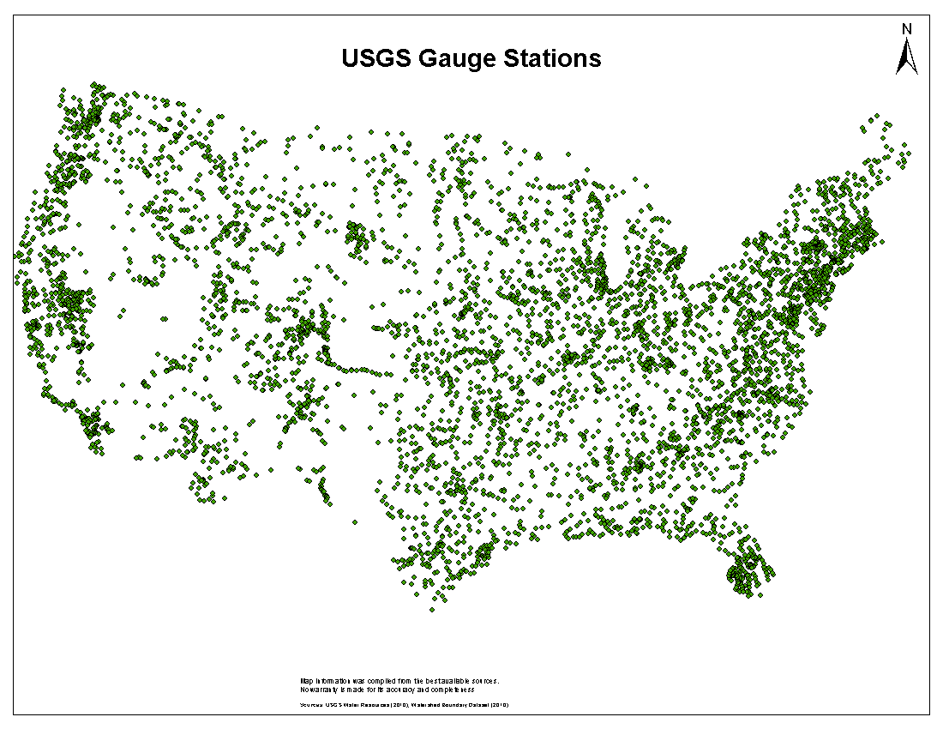
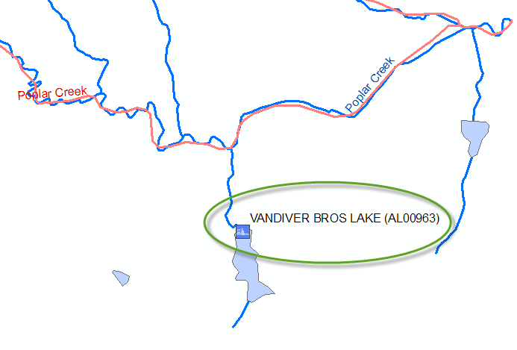
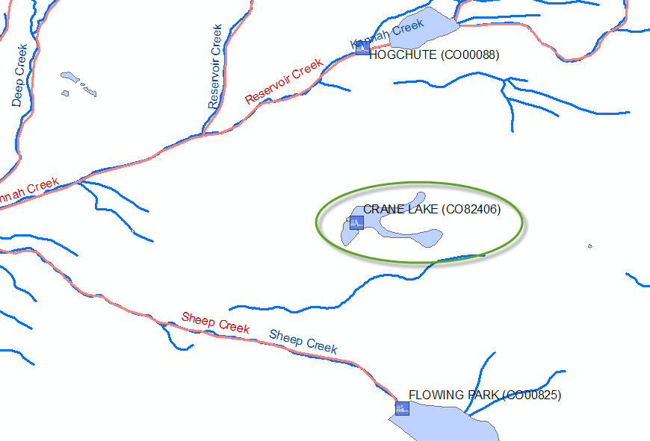
Technical Approach
Federally-chartered data sources (NID, NHD)
Elimination of erroneous and powered dams as opportunities
Accurate snapping of dams to stream segments
Appropriateness for hydropower-specific analysis
Accurate estimation of potential energy (head) – TW and HW info
Accurate estimate annual and seasonal flows for power generation
Regional, empirical capacity factor used to convert estimated annual production (MWh) to Rated Capacity (MW)
Communication and Collaboration
Bureau: Review of resource assessment
USACOE: Hydraulic head on all locks & Dams
TVA: Database
FERC Database
NID: National Inventory of Dams: Maintained by COE for Dam Safety
NHD: National Hydrography Dataset
Notes:
NID: National Inventory of Dams
NHD: National Hydrography dataset

Slide 4
Plan, Schedule, & Budget
Schedule:
Initiation date: September 2009
Completion date: September 2011
Update the existing geospatial assessment of NPD, validate locations, screen for development feasibility, Aug. 2010
Aggregate existing GIS-based environmental information, Aug. 2010
Produce a statistical model to assess Monthly, seasonal and yearly variability of streamflow, Aug. 2010
Code and convert preliminary environmental indices as GIS layer attributes for analysis, Nov. 2010
Produce GIS layers for site characteristics/power potential for non-powered dams, Jan. 2011
Submitted for expert panel reviewers, March 2011
Capacity results published at 2011 NHA Annual Meeting, April 2011
Finalized draft of resource assessment report to DOE, Sep. 2011
Results available via NHAAP Public Portal November 2011
DOE Report to be published in November 2011
Budget:
Budget History
FY2009 |  | FY2010 |  | FY2011
DOE | Cost-share | DOE | Cost-share | DOE | Cost-share
 |  | $589K

Slide 5
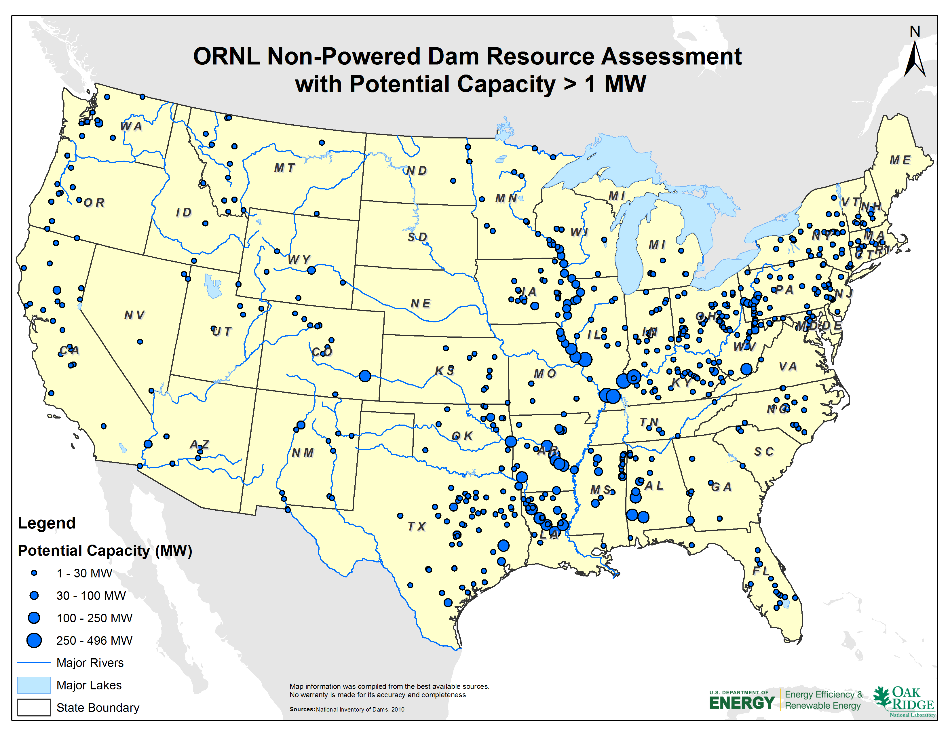
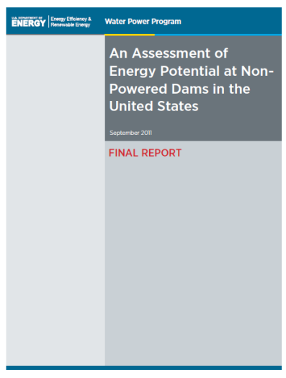
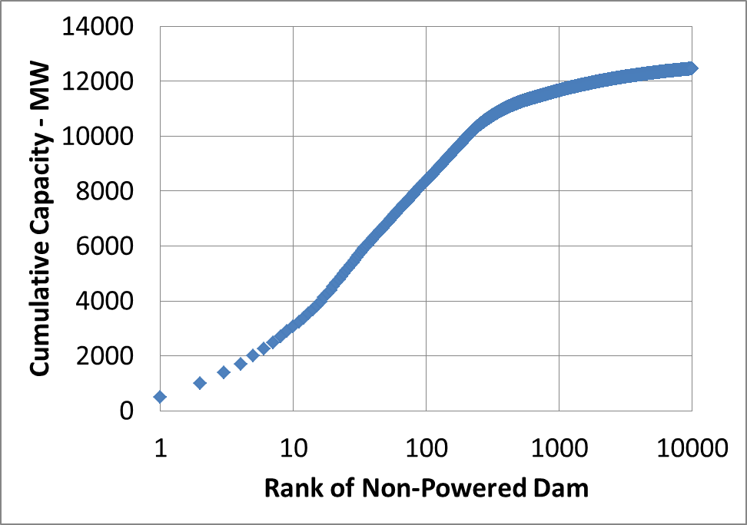
Accomplishments and Results
Potential National = 12.6 GW
The NPD Top 10:
3 GW at Corps of Engineers Facilities
4 Ohio River Dams
1 Mississippi River Facility
1 Alabama River Facility
2 Tombigbee River Facilities
1 Arkansas River Facility
1 Red River Facility
The NPD Top 100 includes 8 GW
Including 81 Federal (Corps) facilities
Reclamation facilities: 260 MW
In Construction:(not included in the assessment)
Cannelton: 2-unit (44 MW)
Smithland: 2-unit (48 MW)
Meldahl: 3-unit (111 MW)
Nov 2011
In Planning or Design:
Willow Island: 3-unit (84 MW)
RC Byrd: 3-unit (76 MW)

Slide 6
Challenges to Date
Accuracy of the dam features
NID dam coordinates have not been fully checked and linked to NHD flowlines by the USGS NHD team.
NID classification of hydroelectricity dams are not fully accurate.
Some NID attributes (e.g., dam heights, drainage area) are missing or inaccurate.
Some of the Reclamation’s dams are not included in NID (e.g., Hoover).
Accuracy of the hydraulic head for power generation
Lack of measurements of hydraulic head at all NPD
The backwater effects of run-off-river dams cannot be reflected by using the NID heights. This problem was partially solved by including all USACE locks and dams hydraulic height.
Accuracy of the flow estimates
Lack of measurements of flow at all NPD
Derive daily-based flow-duration curves for 55,707 dams is a challenging task.
No single flow estimation method can be solely used.
Further close collaboration with USGS could improve the flow estimates.
How to estimate the parameters consistently and exhaustively for the entire US
Accurate stream datasets are essential
“Tiny” NID dams will be placed on major rivers if the stream datasets are not fine enough
Combined usage of HR-NHD and MR-NHDPlus
HR and MR: High Resolution and Medium Resolution

Slide 7
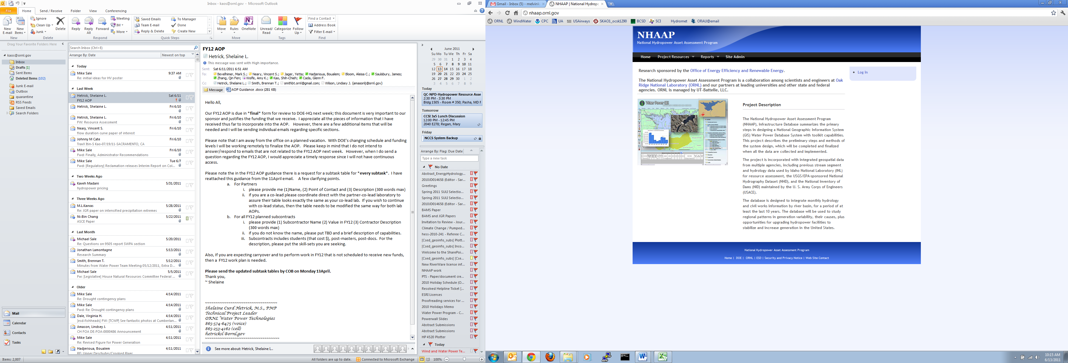
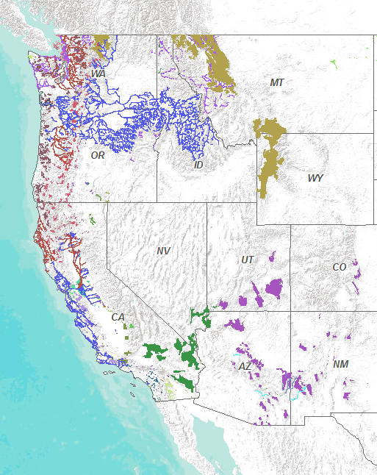
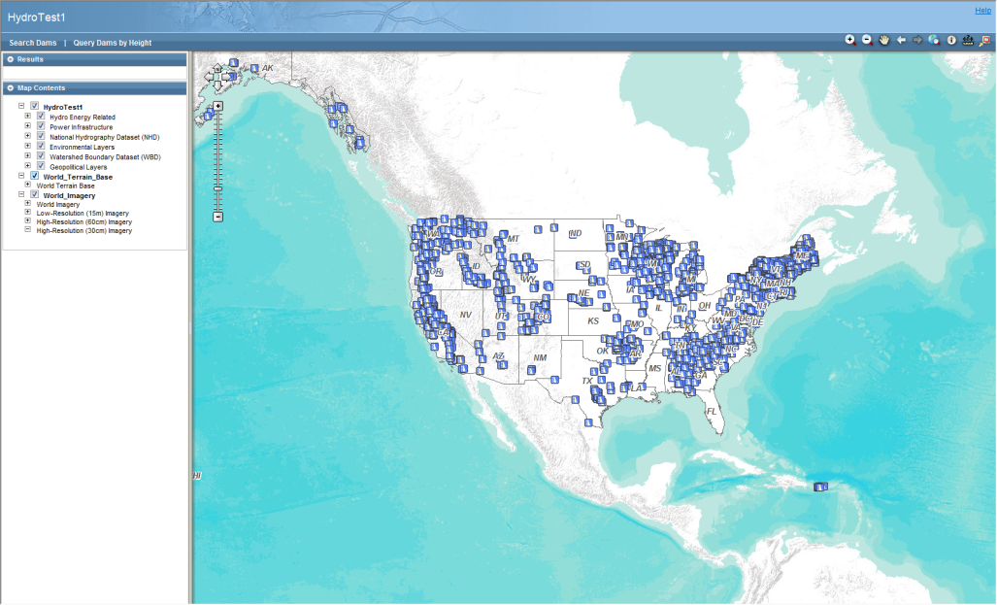
Next Steps
NPD Results are now in the NHAAP
FY2012 work related to NPD is included in the NHAAP Baseline and Environmental Attribution Efforts
Fact-based environmental data overlays and statistics (Critical species, Impaired streams, …) for all resource classes (NPD, PSH, new hydro, constructed waterways)
Enhanced flow statistics for all resource classes
Future needs
Interface with Corps of Engineers on detailed assessment of Top 100 (primarily gross/net head)
Intelligent penstock diversion model for mountainous regions
Updated cost estimators for powerhouse construction

Slide 8
Additional Slides
The following slides are for information purposes only

Slide 9
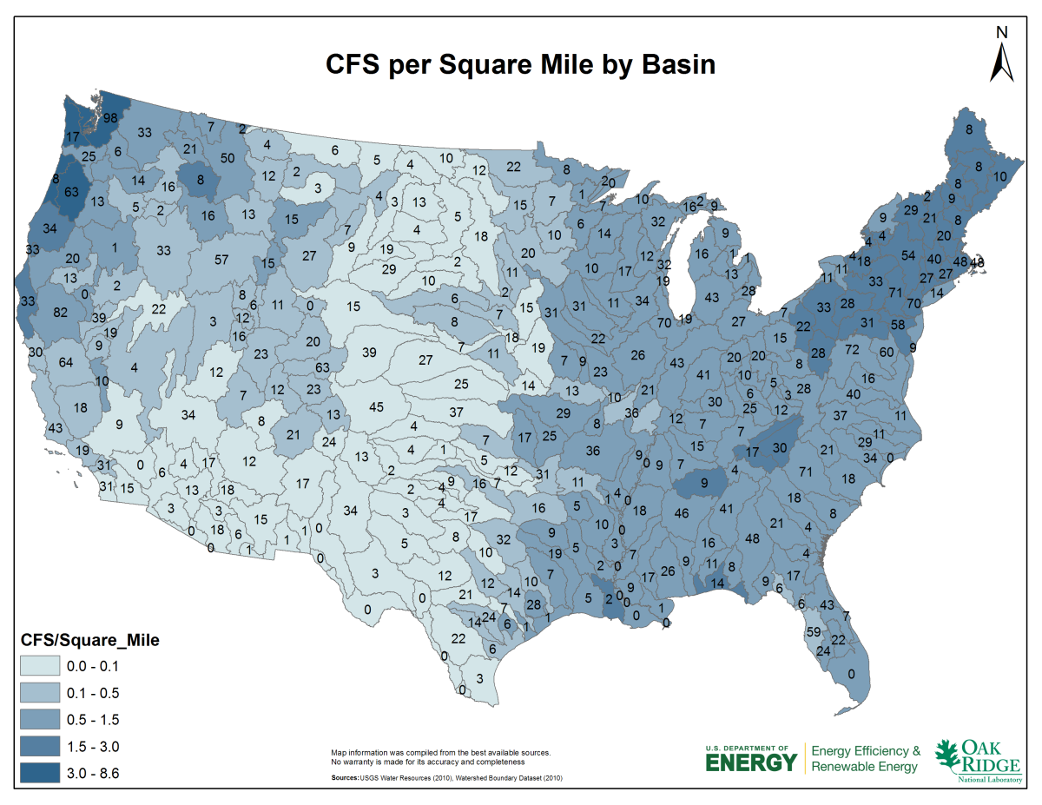
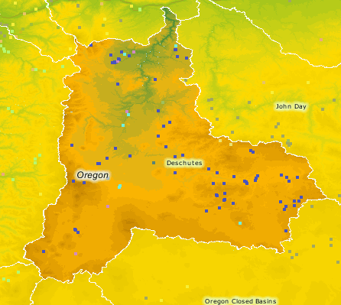
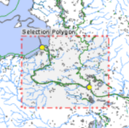
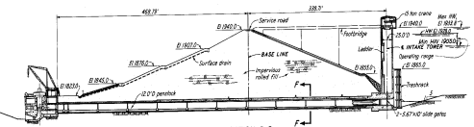

Hydropower Assessment & Development Paradigm
Scale
Environmental Planning
Generation Planning
Project Developers
Users & Uses
Policy Analysis
Research Programming
Transmission Planning
Site-Specific Feasibility
Technology Deployment
Project Developers
Increasing Detail
Decreasing Uncertainty
Clarity
Modeling &
Remote Sensing
Site-Specific
Assessment
Roles
Government
Industry

Slide 10
Selection of Non-Powered Dams (I)
Total NID Archive (83,987 dams)
Update NID coordinates
Dam coordinates were adjusted using HR-NHD: 41,757
Additional quality control via satellite image
Removed dams:
Invalid locations: 697
Outside of the conterminous US: 267
Excluded: powered, auxiliary, and low head dams (H < 5ft)
NID-defined hydroelectricity dams: 2,569
Auxiliary dams: 703
Dams with NID_Height < 5 ft or no NID_Height information: 319
Note: Numbers of dams listed here may overlap. For example, a dam may be an auxiliary dam with NID Height less than 5 ft.

Slide 11
Selection of Non-Powered Dams (II)
Remove dams on tiny streams or can’t be matched to any flow line
This was achieved using spatial analysis over NID, HR-NHD, and NHD-Plus datasets.
Dams identified on tiny streams: 17,785
Dams not linked to any NHD or NHD-Plus stream (due to inaccurate coordinates or being too small): 6,693
NHD Flowline (High Resolution)
NHD-Plus Flowline (Medium Resolution)
NID Dam
Dam “Vandiver Bros Lake” is close to NHD flowline but far from NHDPlus flowline, it is on a tiny stream
Dam “Crane Lake” is not close to any NHD flowline or NHDPlus flowline, it can’t be linked to any stream

Slide 12
Estimate Hydraulic Head (ΔH) for power generation
Start with 55,707 non-powered dams of interest
Given the large amount of candidates, exhaustive survey of actual hydraulic head of all dams is considered impossible.
Basic estimate
For any dam with NID_Height: ΔH = 0.7 * NID_Height
NID_Height is the maximum of three different heights (see box below, NID definitions)
More accurate estimate
ΔH = Hydraulic_Height: (not included is the tailwater depth)
If Hydraulic_Height and NID_Height are both provided and Hydraulic_Height < NID_Height
Over-estimate for run-of-river dams and navigation locks
Most accurate estimate
ΔH = USACE lifts for all locks and dams => largest potential in NPDs
Hydraulic_Height: Vertical difference between the maximum design water level and the lowest point in the original streambed.
Dam_Height: Vertical distance between the lowest point on the crest of the dam and the lowest point in the original streambed.
Structural_Height: Vertical distance from the lowest point of the excavated foundation to the top of the dam. Top of dam refers to the parapet wall and not the crest.
NID_Height: Maximum value among Hydraulic_Height, Dam_Height, and Structural_Height.

Slide 13
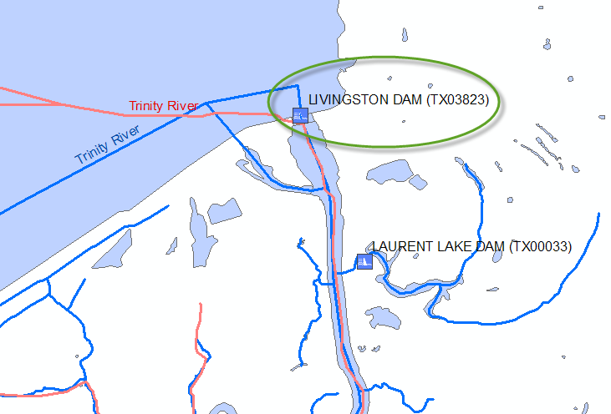
Estimate flow (Q) for power generation (I)
Challenge: Daily flow-duration curves are unlikely to be developed for 55,707 NPDs given the current timeline, resources, and lack of flow information => Seek for alternatives on the national scale
Collect drainage area for candidate dams
Link a NID dam to the correct NHD-Plus flowline and use the accumulative drainage area as the NPD drainage area
If a NID dam can’t be linked to a NHD-Plus flowline, then use the NID drainage area when available
There are 906 dams with no drainage area information from both NID and NHD-Plus
NHD Flowline (High Resolution)
Dam “Livingston Dam” is linked to an NHD-Plus flowline (in red color), which represents the Trinity River. The cumulative drainage area for this NHD-Plus flowline is 16,572 square miles, which will be used as the dam’s drainage area
NHD-Plus Flowline (Medium Resolution)
NID Dam

Slide 14
Estimate flow (Q) for power generation (III)
Compute runoff (cfs per square mile) from USGS NWIS gauges
Select 5,595 USGS gauge stations with continuous streamflow observations between 1999 and 2008
Derive monthly mean runoff (cfs per square mile) for each HUC06 unit (basin level) based on the observed flow, location, and drainage area of the selected gauge stations
Temporary solution until the new NHD-Plus is released
Observed flow for selected USGS gauge stations
Runoff (CFS/Square_Miles)

Slide 15
Compute Potential Capacity
Estimate potential capacity from potential generation
The NHAAP generation-weighted capacity factor (C_{f} ) for each hydrological region (HUC02) is utilized to compute the NPD Potential capacity (MW).
C_{f} is computed based on all EIA hydropower capacity and generation data from 2001 to 2008.

Slide 16
Accomplishment and Results
NPD Hydropower Potential in the U. S. : 12.6 GW at 54,384 Dams
The Top 600 Non-Powered Represent 90% of the Non-Powered Dams total potential capacity (54,384 dams)

Slide 17
Quality Control
General observations
No single set of rules can be used to fully-automate the analysis.
Quality control through manual check is crucial, but it is an extremely time-consuming process.
The current quality control was performed following the descending order of power potential (from large to small NPDs to control over-estimation).
Known major issues
The NID hydropower dam notation could be outdated and inaccurate.
Around half of the NID coordinates have not been corrected by HR-NHD.
Small dams next to major rivers could easily lead to serious overestimation.
NID heights tend to over-estimate the head for run-off-river dams.
Evolvement of the ORNL NPD Resource Assessment
First estimate:
54,801 NPD with 43.5 GW potential capacity
Preliminary quality control (not including USACE L&D correction):
54,561 NPD with 19.7 GW potential capacity
Current estimate (all NPDs greater than 1MW were checked):
54,384 NPD with 12.6 GW potential capacity

Slide 18
Using NHAAP to Estimate flow (Q) for power generation (II)
Livingston Dam, a Non-Powered Dam on Trinity River, Texas. The USGS gauge
station just downstream of the dam with a monthly measured flow record
was used to estimate the potential power generation.

Slide 19
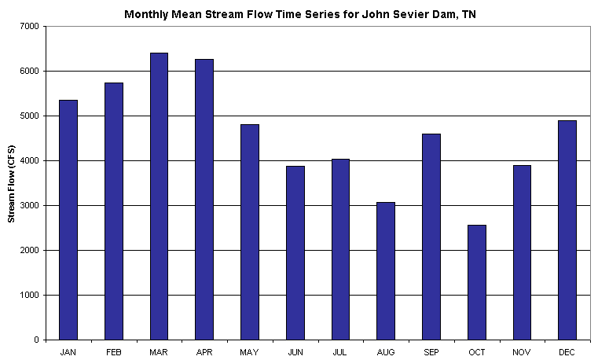
Estimate flow (Q) for power generation (IV)
Calculate the monthly mean flow
For each non-powered dam of interest, identify which basin (HUC06) it is located, then use the corresponding monthly mean runoff and drainage area to calculate the monthly mean flow.
If the computed annual mean flow is not within 10% difference of NHD-Plus flow, the monthly mean flow is adjusted proportionally.
Subject to further site-by-site checking
Apply monthly mean flow to compute power generation

Slide 20
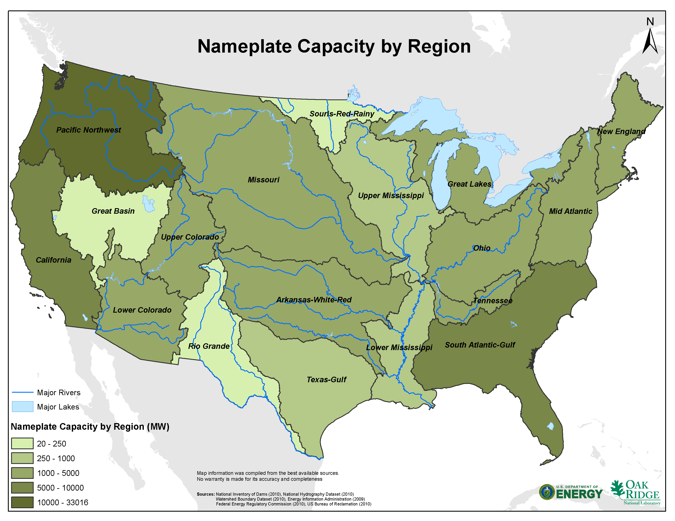
Existing Hydropower Generation Distribution and Future Potential
…….. Will help the current hydropower distribution in the US

